Slide 1
Employment & Poverty In The United States
Presented By: The Data Vikings

Slide 2



Meet The Team
Jake Uhl
BA in Chemistry
Before Dev10: Engineering Technician
Favorite Topics: SQL, Databases & Python
Kendra Johnson
BS - Computer Science
Minor: Mathematics
Austin Peay State University
Favorite Topics: Python/Pandas, SQL, Power Bi
Sam Moe
BA in Computer Science - University of Minnesota
Favorite Topics: SQL & Power Bi

Slide 3
Introduction
Employment = income / occupations / unemployment rates
Poverty = rates / threshold
Agenda:
Analysis at three different levels
Machine Learning
Dashboard
National
State
County

Slide 4
Questions
National:
How has the poverty rate and annual median income changed over time?
How does annual median income compare to the poverty threshold over time?
State:
Do certain geographical areas tend to have higher poverty?
Do areas with generally higher or lower poverty tend to have different proportions of employees working in different job sectors?
How have poverty rates changed relative to income in recent years?
County:
Are the poverty rates rising proportionally to unemployment rates for Minnesota counties?
What are the trends in poverty vs unemployment rates? Are the counties in Minnesota following the current trends in poverty rates vs unemployment rates?
Are the poverty rates rising proportionally to unemployment rates?
Are the poverty rates rising proportionally to unemployment rates??

Slide 5
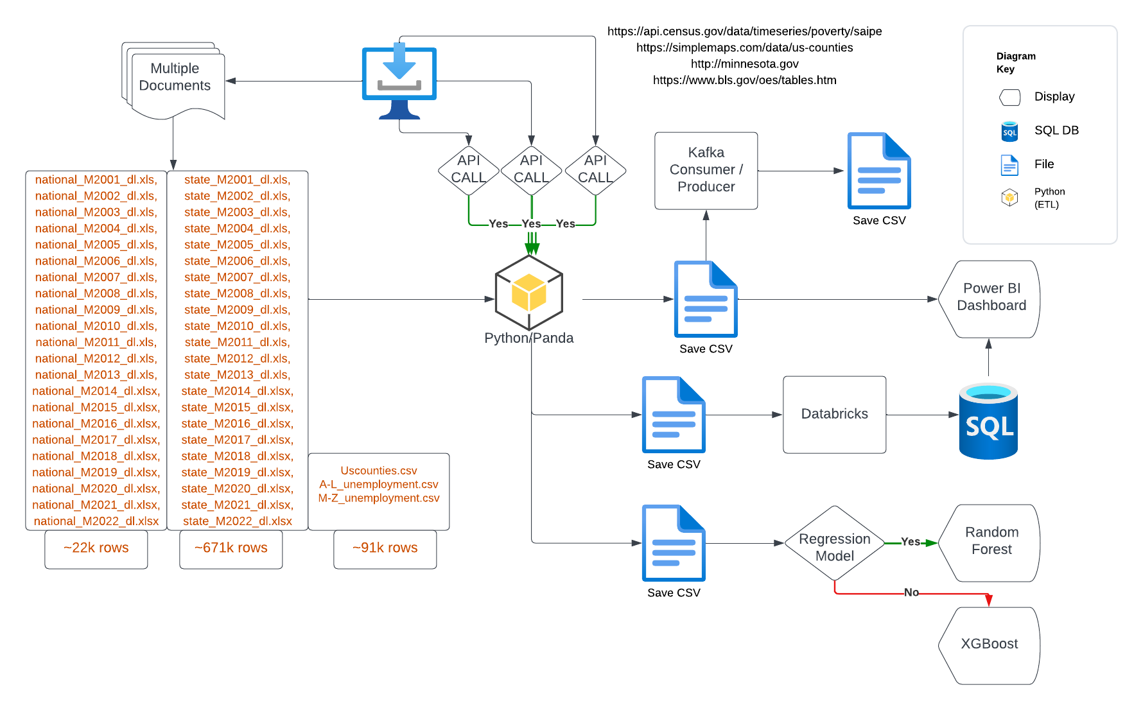
ETL Pipeline

Slide 6
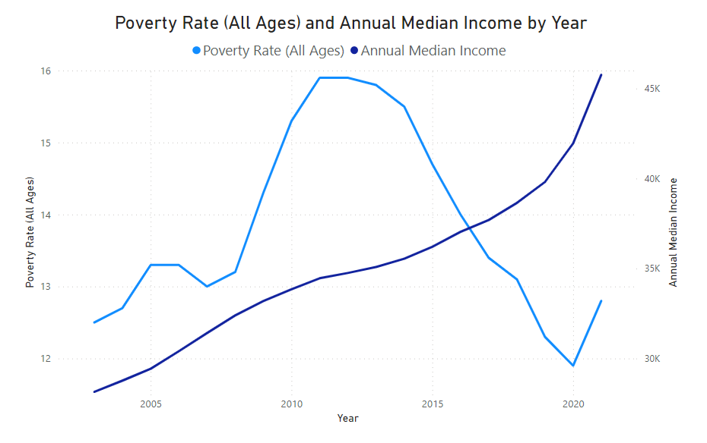
National Level - How has the poverty rate and annual median income changed over time?

Slide 7
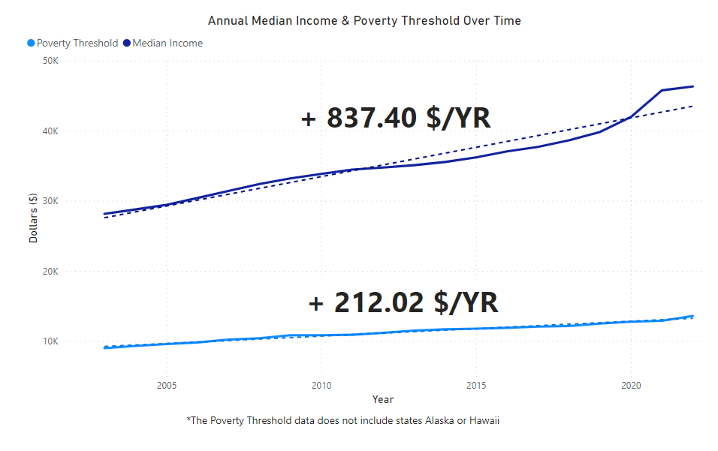
National Level - How does median income compare to the poverty threshold over time?

Slide 8
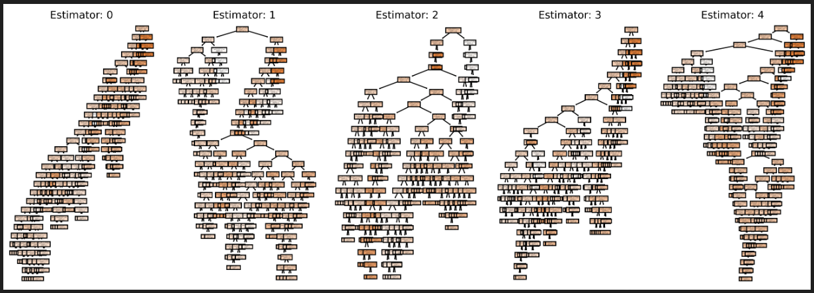
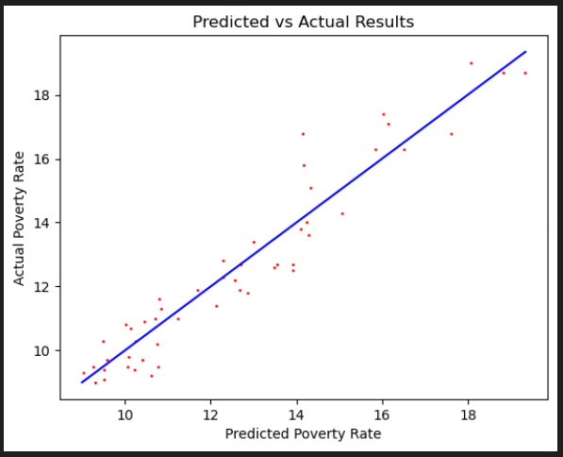
Machine Learning: Random Forest Regression
Target: Poverty Rate
Linear Regression -> XGBoost -> Random Forest
Random Forest Regression - 1000 Estimators
53 Features:
Total Employees per occupation sector
Number of jobs in each occupation sector per 1000 people
Location Quotient - ratio of an occupation’s share of employment for a given area
Each of the 50 States - dummies
Performance
Training Accuracy (R²): 98.3%
Testing Accuracy (R²): 91.8%
Mean Squared Error: 0.661
Out-of-bag Score: 87.9%
Location, location, location

Slide 9
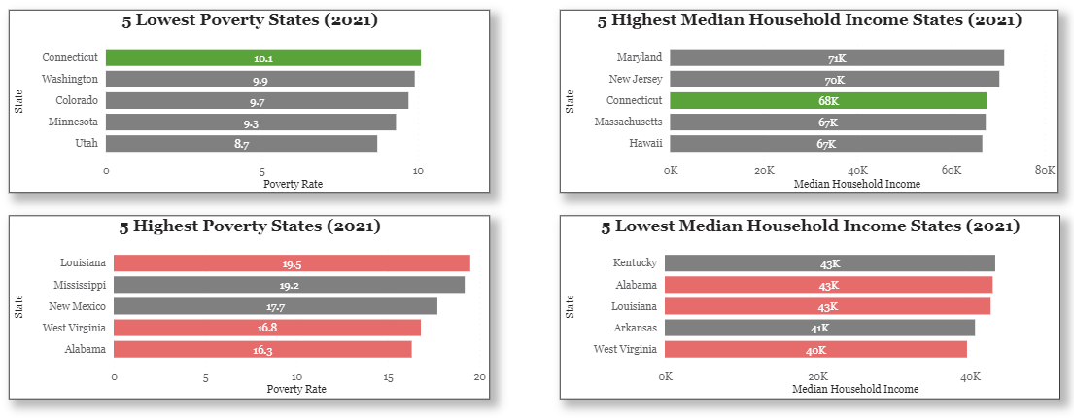
Poverty and Income at the State Level

Slide 10
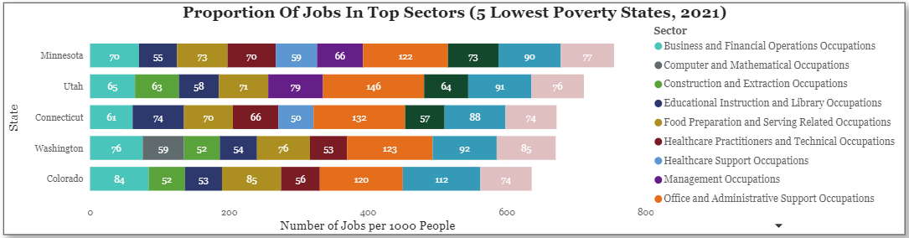
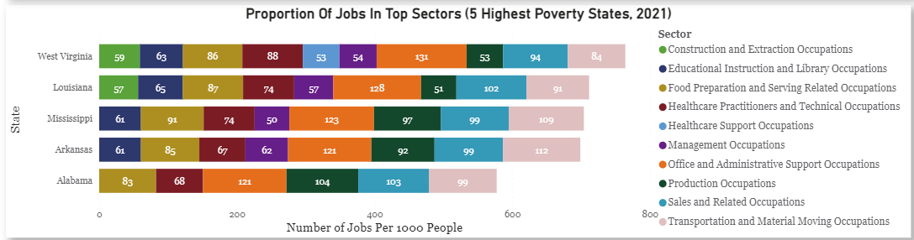
Job Sectors in States With Lowest and Highest Poverty

Slide 11
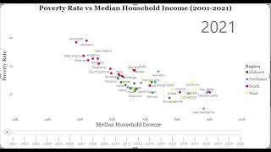
Time Series: Poverty vs Household Income (2001-2021)

Slide 12
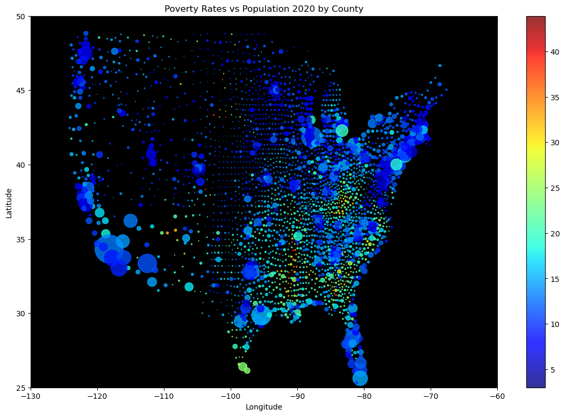
Median Incomes by
Top/Bottom 3 Poverty Rates
Poverty Rates by
Top/Bottom 3 Median Incomes
Do income levels dictate poverty levels?
County, State | PR | Med HH Income
Ziebach County, South Dakota | 43.9 | $31,599
Issaquena County, Mississippi | 43.3 | $32,675
Todd County, South Dakota | 42.5 | $31,256
Los Alamos County, New Mexico | 3.3 | $111,724
Loudoun County, Virginia | 3.2 | $155,362
Douglas County, Colorado | 3.0 | $122,290
County, State | PR | Med HH Income
Loudoun County, Virginia | 3.2 | $155,362
Santa Clara County, California | 6.6 | $139,462
Fairfax, Virginia | 5.3 | $132,509
McDowell County, Kentucky | 31.8 | $26,582
Owsley County, Kentucky | 30.6 | $25,997
Buffalo County, South Dakota | 32.8 | $22,901

Slide 13
Median Incomes by
Top/Bottom 3 Poverty Rates
Poverty Rates by
Top/Bottom 3 Median Incomes
Do income levels dictate poverty levels?
County, State | PR | Med HH Income
Ziebach County, South Dakota | 43.9 | $31,599
Issaquena County, Mississippi | 43.3 | $32,675
Todd County, South Dakota | 42.5 | $31,256
Los Alamos County, New Mexico | 3.3 | $111,724
Loudoun County, Virginia | 3.2 | $155,362
Douglas County, Colorado | 3.0 | $122,290
County, State | PR | Med HH Income
Loudoun County, Virginia | 3.2 | $155,362
Santa Clara County, California | 6.6 | $139,462
Fairfax, Virginia | 5.3 | $132,509
McDowell County, Kentucky | 31.8 | $26,582
Owsley County, Kentucky | 30.6 | $25,997
Buffalo County, South Dakota | 32.8 | $22,901

Slide 14
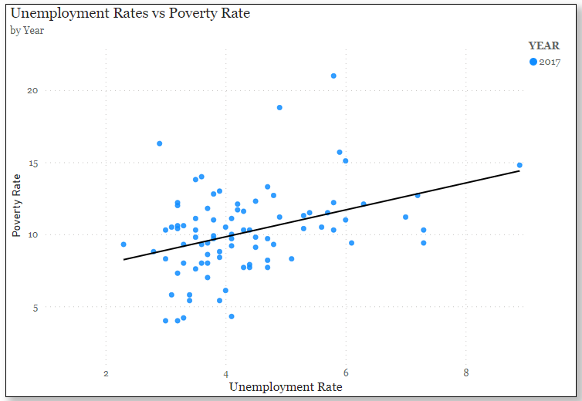
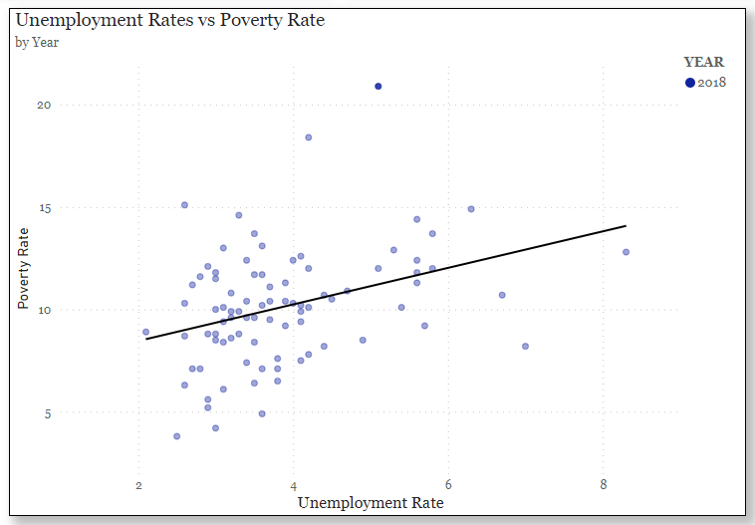
Deep Dive into Minnesota County Data - 2017, 2018
Carver County
4.0 Poverty Rate
3.0 Unemployment Rate
Mahnomen County
21.0 Poverty Rate
5.8 Unemployment Rate
Carver County
3.8 Poverty Rate
2.5 Unemployment Rate
Mahnomen County
20.9 Poverty Rate
5.1 Unemployment Rate

Slide 15
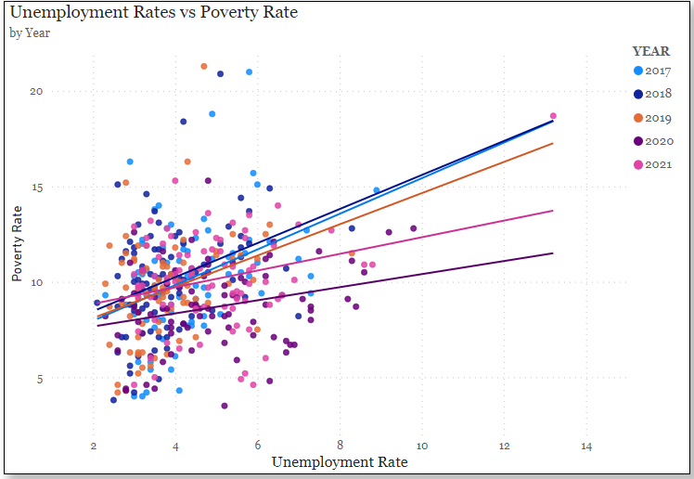
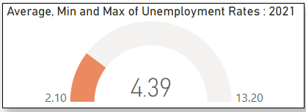
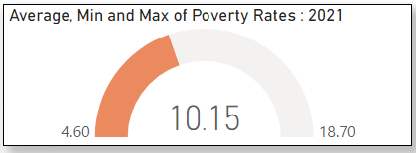
Deep Dive into Minnesota County Data - 2021
Mahnomen County
18.7 Poverty Rate
13.2 Unemployment Rate
Carver County
4.6 Poverty Rate
3.0 Unemployment Rate

Slide 16
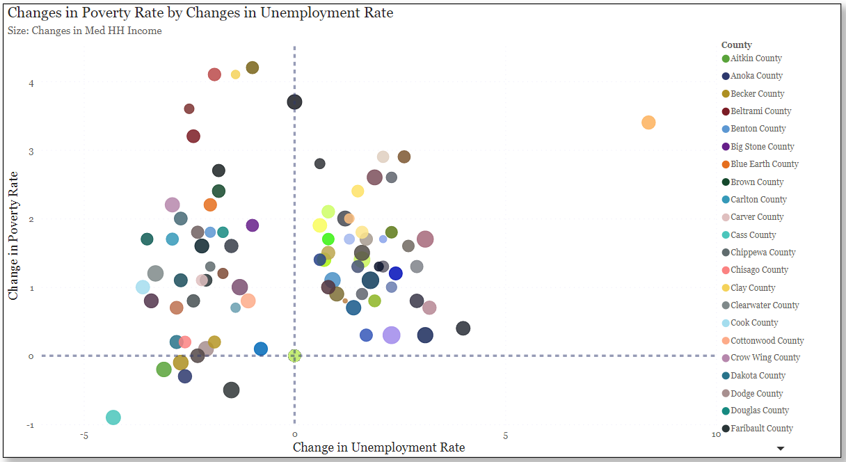
Are the poverty rates rising proportionally to unemployment rates?

Slide 17
Are the poverty rates rising proportionally to unemployment rates?

Slide 18
Are the poverty rates rising proportionally to unemployment rates?

Slide 19
Are the poverty rates rising proportionally to unemployment rates?

Slide 20
Conclusion + Suggestions
Conclusions:
Increases in income do not necessarily mean decreases in poverty.
Location was the most powerful factor in predicting poverty rates.
Areas with high poverty tend to have different proportions of employment in different sectors than areas with low poverty.
Lower unemployment does not necessarily mean lower poverty (Minnesota)
Suggestions for future analysis:
State and local governments -> taxes, social programs
Socioeconomic factors -> Housing market, local economic output
Health factors -> access to healthcare, rates of preventable diseases

Slide 21
Acknowledgements
A special thanks to all of our awesome instructors:
Heather Robbins
Will Sutton
Ben Leboutillier
Beth Campbell
Thank you all for taking time out of your Friday to listen to our presentation.
We hope everyone enjoyed our presentation! Please visit our GitHub repository for more a more detailed look at our capstone project:
https://github.com/sammoe60/data-vikings

Slide 22
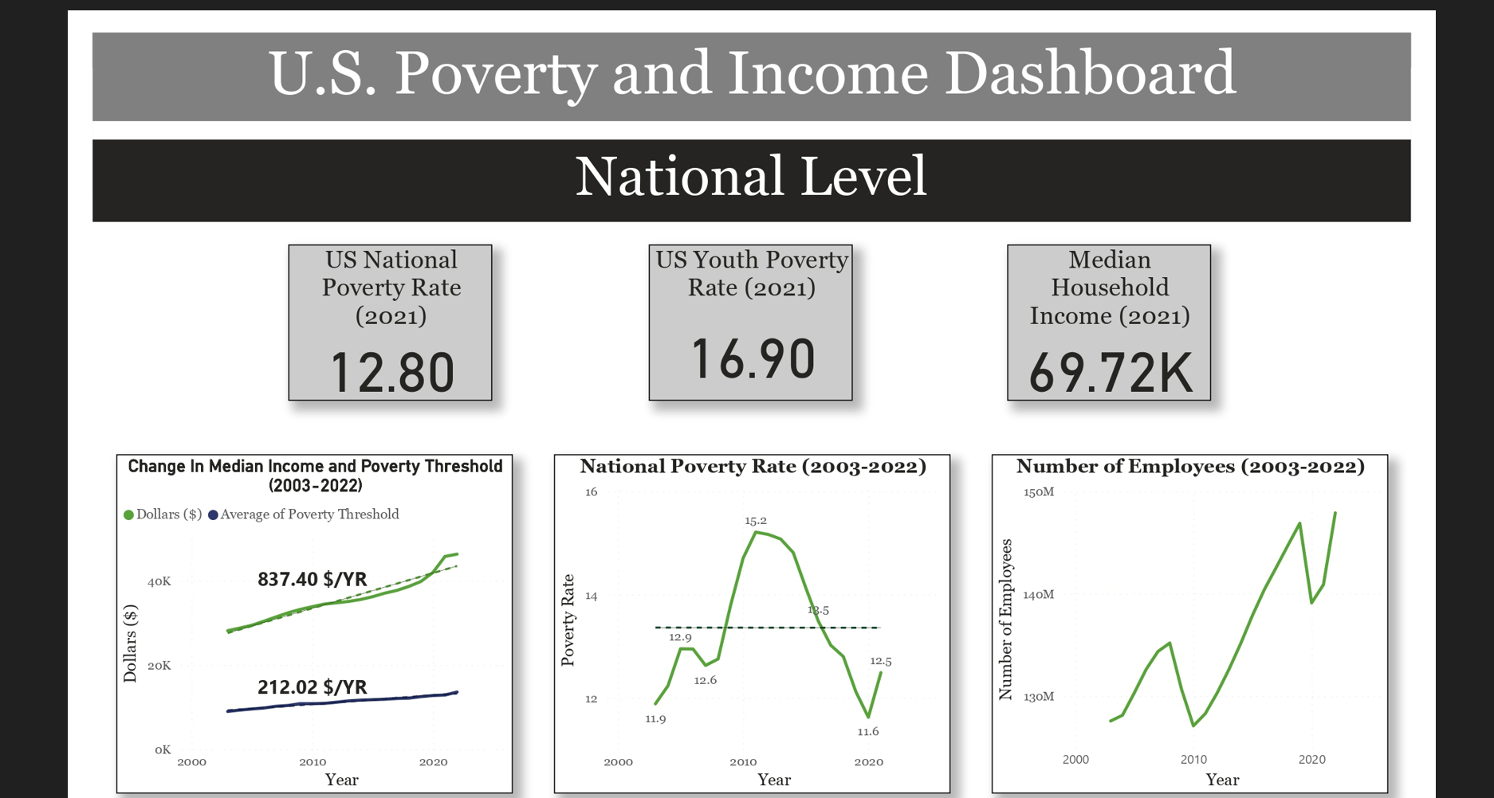
Power BI Dashboard

Slide 23
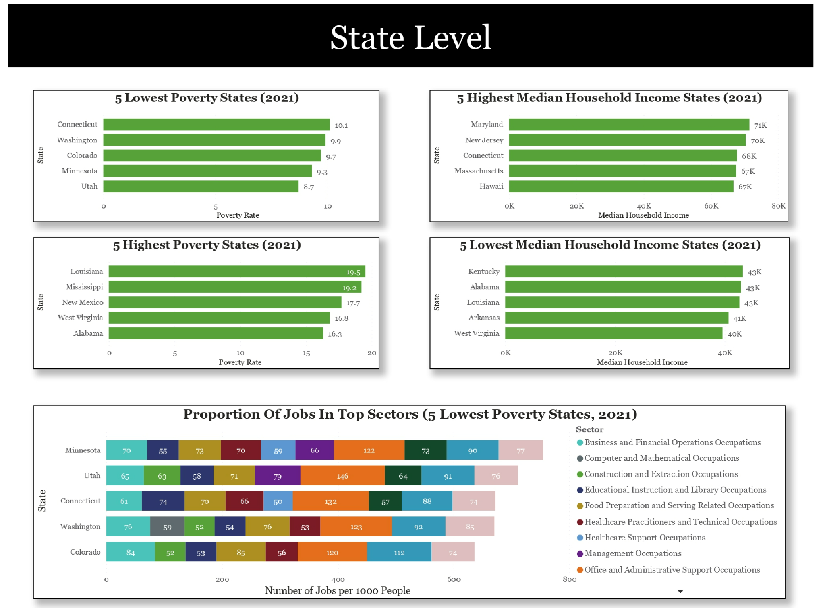

Slide 24
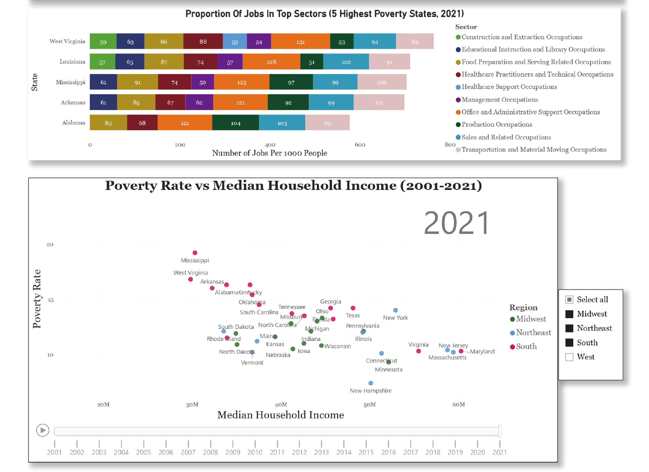

Slide 25
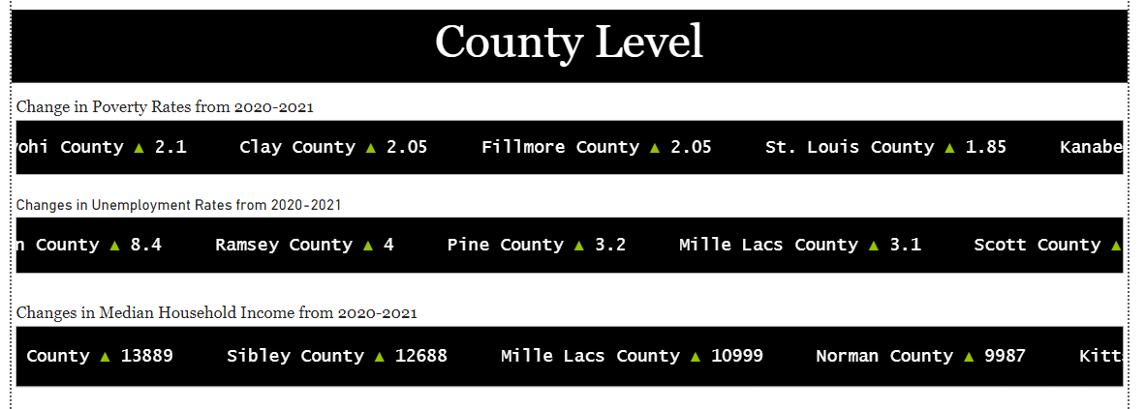

Slide 26
